Slide 1
Microsoft Windows Virtual Desktop
The best virtual desktop experience, delivered on Azure
M A Nakib

Slide 2
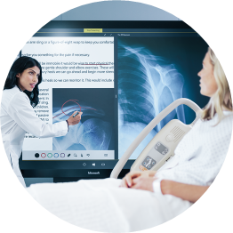



Virtualization scenarios
Security
and regulation
Elastic
workforce
Specific
employees
Specialized
workloads
Financial Services
Healthcare
Government
Mergers and acquisition
Short term employees
Contractor and partner access
BYOD and mobile
Call centers
Branch workers
Design and engineering
Legacy apps
Software dev test
Notes:
Virtualization helps companies address specific business needs:
More secure access to data/organizational resources
Compliance with industry regulations (i.e. FSI, healthcare, government)
An increasingly elastic workforce (i.e. mergers/acquisitions, short-term employees, contractor/partner access)
Employee-specific needs (i.e. BYOD or mobile staff, call centers, branch workers)
Specialized workloads (i.e. design/engineering, legacy apps, software dev test)
Windows Virtual Desktop helps:
Employees stay as productive with a virtualized experience on a PC, phone, tablet, or browser as they are with a physical PC sitting right in front of them
Simplify management, provisioning, and access to corporate data and apps
Support customers as they migrate to the cloud
Reduce the costs and resources associated with managing on-premises infrastructure
Empower IT to transform the workplace

Slide 3
Virtualization hosts today
Windows Server Desktop Experience
Windows 10 Enterprise
Scalable multi – session legacy Windows environment
Native single – session modern Windows experience
Windows Server
Multiple sessions
Win32
Office Perpetual/Office ProPlus (Windows Server 2016, 2019)
Long-Term Servicing Channel
Windows 10
Single session
Win32, UWP
Office 365 ProPlus
Semi-Annual Channel
Notes:
Windows OS that supports multiple active sessions and provides:
Client-like experience including look-and-feel, security updates, UAP, Edge, Cortana, Windows Desktop Search
Client-like app-compatibility (e.g. Office 365)
Server-like user density
Release schedule aligned with Windows and Office Semi-Annual releases
Win32*: Any Win32 application that writes user data outside of the user context (e.g. HKLM, System32, etc.) will not work as expected in multi-session edition.

Slide 4

Windows Virtual Desktop Benefits
Enables a multi-session Windows 10 experience, optimized for Office 365 ProPlus
Supports Windows Server (2012R2+)
Most flexible service allowing you to virtualize both desktops and apps
Windows 7 virtual desktop with free Extended Security Updates
Integrated with the security and management of Microsoft 365
Notes:
JUST DISCUSSED LIMITATIONS SERVER, TAKING BEST OF TWO.
WIN7 ESU, ONLY PAY FOR AZURE CONSUMPTION.
AZURE, SCALE IN MINUTES
FULL DESKTOP/APPS (other cloud providers don’t provide this)
CONDITIONAL ACCESS, INTUNE.
Lets take a look at the high level architecture.

Slide 5
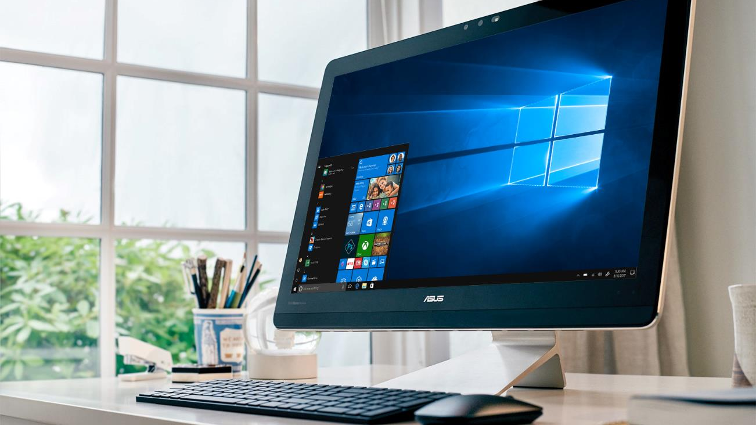
Supported OS
Supported OS
Windows 10 Enterprise Multi-session
Windows 10 Enterprise Single-Session
Windows 7 Single-Session
Windows Server 2019
Windows Server 2016
Windows Server 2012 R2
VMs in customer’s Azure subscription

Slide 6
Prerequisites
Requirements
Azure subscription
Azure Active Directory
Determine your identity strategy (AD, Azure AD DS)
All associated Azure resources (image, virtual network, storage) in one region
Required credentials (Azure AD, WVD tenant, Service principle, etc.)
Notes:
Prerequisites needed to deploy WVD:
Azure Subscription – Deploy virtual machines, network resources, and all the items you typically need to spin up a VM
Azure Active Directory – If using O365, Intune, or other Microsoft cloud service, that means you already have this. If not, there is tons of documentation that describes how to set up Azure AD.
Determine your identity strategy (AD, ADDS) - more on this in the next slides.
All associated Azure resources – Tip: ensure these are deployed in same region. Not requirement but helpful.
Required credentials – more info on this in the next slides.

Slide 7
Network requirements and considerations
Requirements
Considerations
Network must route to a Windows Server Active Directory (AD)
Connectivity Type |  | Special Considerations
ExpressRoute | Hybrid | Dedicated network through service provider
Site-to-Site VPN | Hybrid | Limited bandwidth compared to ExpressRoute
Azure AD Domain Services | Isolated | Must synchronize password hashes to Azure AD
This AD must be in sync with Azure AD so users can be associated between the two
VMs must domain-join this AD

Slide 8
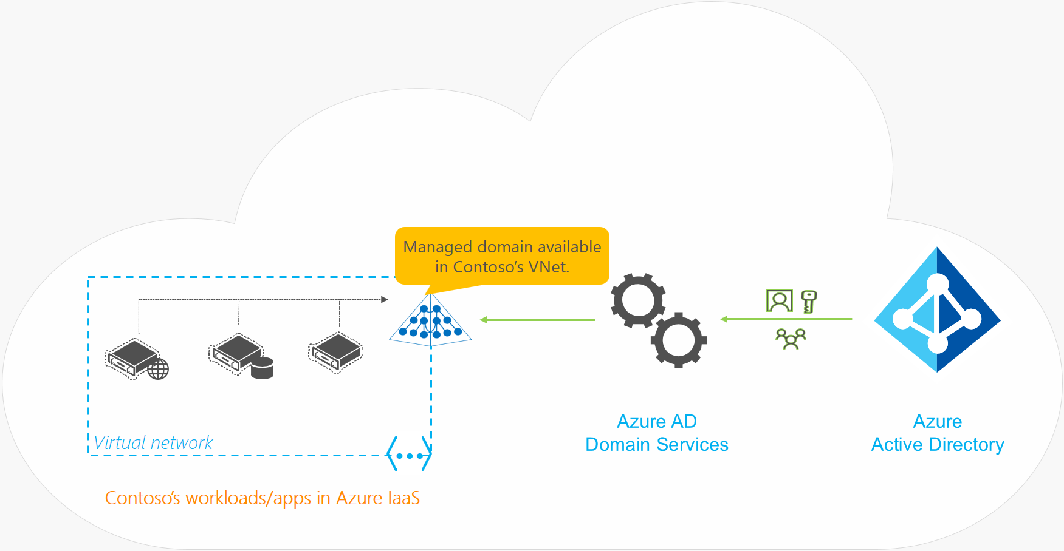
Recommended identity setup for cloud-based organizations
Azure AD
Azure AD Domain Services
Windows Server AD run as a service by Azure​
Allows VMs to be domain-joined​
Users recognized both in Azure AD and Windows Server AD

Slide 9

Recommended identity setup for hybrid organizations
Azure AD
Windows Server AD on-prem connected to Azure
ExpressRoute or site-to-site VPN to Azure
Azure AD Connect to synchronize identities
Notes:
Azure AD
Azure AD Domain Services​
Windows Server AD run as a service by Azure​
Allows VMs to be domain-joined​ so users and VM’s are recognized both in Azure AD and Windows Server AD
Ex. When using this service, everything that happens in your Azure AD is automatically replicated to domain controller that’s being run for you as managed service. Ex. User changing password will be replicated.

Slide 10
Implementation Guidance – infrastructure management
Master image can be managed by any already existing process and technologies including
Azure Update Management
System Center Configuration Manager
3rd party
Best practices document will be provided to assist in configuration of a golden image for WVD
Application masking technology to minimize the number of golden images and simplify app image management

Slide 11
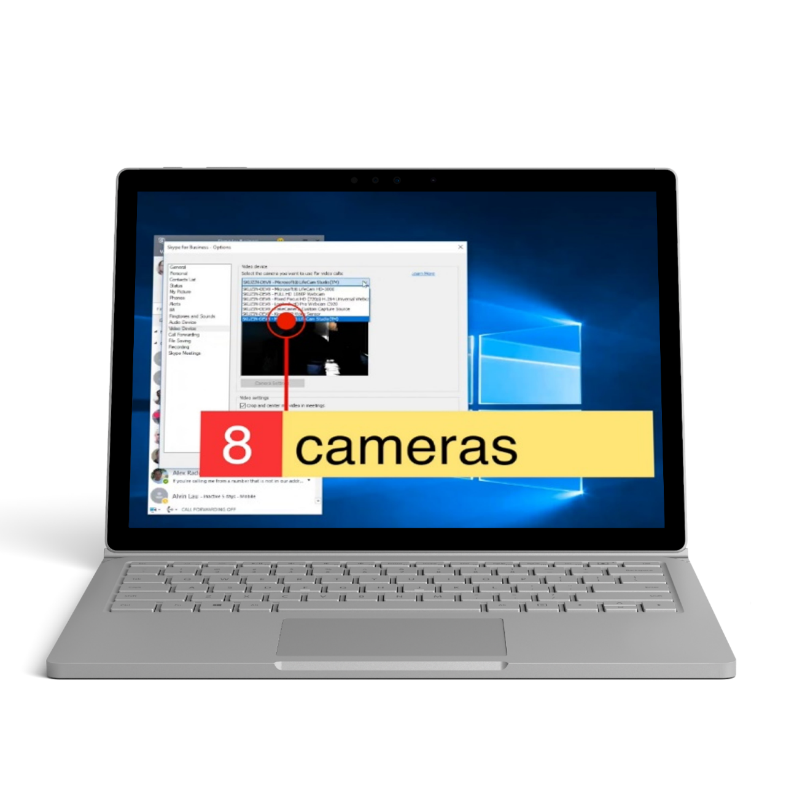
Device redirection
High-level redirection of built-in or attached video camera
Less network bandwidth compared to USB camera redirection
Increased video framerate, up to 30 fps
Redirect multiple cameras
Improved printing messages
Built-in Windows client first to adopt
Notes:
Printing messages:
Print start
Progress
Success/error user messages
Teams: Teams will support WVD including fully optimized calling and meeting experiences, work is already underway and we will provide update in coming months

Slide 12
Virtualizing Windows Server
Supports 2012 R2, 2016, and 2019
If an older version, suggest upgrade to newer version or refactor app for Windows 10 multi-session
Office 365 ProPlus support only in Windows Server 2016 and 2019
2012 R2 only supports Office perpetual
Use Windows 10 Enterprise multi-session for best experience
Requires the use of Windows Server VMs on Azure but can leverage Azure Hybrid Benefit for cost savings
Windows Server RD Session Host
Scalable multi-user legacy Windows environment. Windows Server
Multiple users
Win32
Office Perpetual or Office 365 ProPlus (Windows Server 2016/2019)
Long-Term Servicing Channel

Slide 13











Azure AD
contoso.com
contoso.onmicrosoft.com
AAD Sync (Over Internet)
Domain Controller Replication (Over S2S VPN)
ADDC
(running AAD Connect)
contoso.local
VNET
Peering
FS01
100.64.2.4
FS02
100.64.2.5
ADDC
10.10.10.5
Mgmt Subnet: 10.10.10.0/24
Fileserver Subnet: 100.64.2.0/24
Default Tenant Group
Tenant Name: XXXX01
Hostpool Name: XXXXHP01
App Groups:
Desktop AG 1
Remote Des.
Hostpool Name: XXXXHP02
App Groups:
Desktop AG 2
Remote Des.
App AG 2
Word
Excel
Hostpool Name: XXXXHP03
App Groups:
Desktop AG 3
Remote Des.
App AG 3
WordPad
Azure Firewall or NVA
10.10.20.4
(Public IP: X.X.X.X)
Win10
(Persistent)
Can be N-Series
On-Premise gateway
S2S VPN over Internet
Or ExpressRoute
Azure VPN Gateway 10.10.0.4
(Public IP: X.X.X.X)
Win10 EVD + O365
(Pooled)
GW Subnet: 10.10.0.0/24
FW Subnet: 10.10.20.0/24
[agent]
Win2016 (Pooled)
WVD Subnet: 100.64.1.0/24
[Over MS Backbone]
VNET: (10.10.0.0/16)
West Europe
DNS: 10.10.10.5
WVDVNET: (100.64.0.0/16)
West Europe
DNS: 10.10.10.5
WVD Clients
Web Access
Diagnostics
WVD Web/Downloadable Client (Over Internet)
Gateway
Broker
Mgmt.
wvdadmin@contoso.onmicrosoft.com(Tenant Creator)
Rest API
Azure SQL DB
PowerShell
WVD PaaS Service: EastUS2/CentralUS (during preview)
On-premises network

Slide 14

Azure AD
contoso.onmicrosoft.com
contoso.com
AAD Sync
adVM - 10.0.0.4
(running AAD Connect)
Contoso.local
fs01 - 10.2.0.4
adSubnet: 10.0.0.0/24
fsSubnet: 10.2.0.0/24
Default Tenant Group
Tenant Name: Contoso-WVD-Tenant
Hostpool Name: ContosoHP01
App Groups:
HP01-AG01
Remote Des.
Hostpool Name: ContosoHP02
App Groups:
HP02-AG01
Remote Des.
HP02-AG02
Word
Excel
Hostpool Name: ContosoHP03
App Groups:
HP03-AG01
Remote Des.
HP03-AG02
WordPad
user01@
Win10
(Persistent)
Can be N-Series
Win10 EVD + O365
(Pooled)
[agent]
user2@
Win2016 (Pooled)
wvdSubnet: 10.0.1.0/24
[Over MS Backbone]
adVNET: 10.0.0.0/16
EastUS2
DNS: 10.0.0.4
user03@
WVD Clients
Web Access
Diagnostics
WVD Web/Downloadable Client (Over Internet)
Gateway
Broker
Mgmt.
admin@contoso.com (Tenant Creator)
Rest API
Azure SQL DB
Note: AADDS can also be used instead of AD
PowerShell
WVD PaaS Service: EastUS2/CentralUS (during preview)

Slide 15
Full desktop vs. RemoteApp
Based on what your users need to do.
Full desktop
Use RemoteApp
Power Users / Developers that need to install their own apps or admin privileges
Clients lack computing power / outdated
Clients vary widely and application consistency is impacted
Different version of the same app from different OS
Notes:
Windows OS that supports multiple active sessions and provides:
Client-like experience including look-and-feel, security updates, UAP, Edge, Cortana, Windows Desktop Search
Client-like app-compatibility (e.g. Office 365)
Server-like user density
Release schedule aligned with Windows and Office Semi-Annual releases
Win32*: Any Win32 application that writes user data outside of the user context (e.g. HKLM, System32, etc.) will not work as expected in multi-user edition.
Provides a full Windows 10 Enterprise experience, including Edge, Cortana, and Store
Best Office 365 ProPlus experience in multi session
Reduces IT costs by scales 4× users compared to Windows 10 Enterprise
Simplified management on Azure with a single image for both single-session and multi-user
Compatible with SCCM/Intune
GPU acceleration for encoding and video provides improved responsiveness and smooth video playback
User can use built-in or attached cameras in remote applications or remote desktops with new and legacy Windows applications

Slide 16
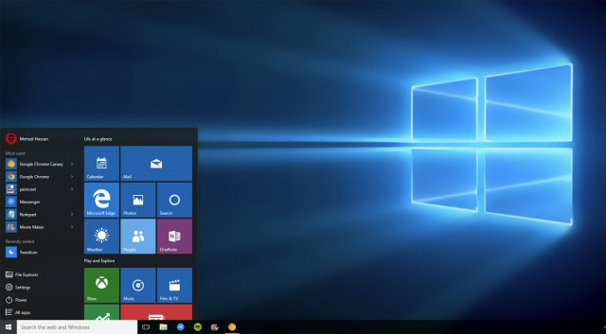
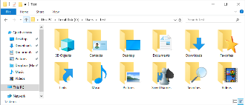




Uses native Windows VHD capabilities–no hypervisor.
Very easy to deploy and manage.
Completely seamless end-user experience.
Works with other application management platforms.
Easy to test, implement, and manage.
Reduces network and filesystem load.
Benefits
Container
Container
Profile Container
Office 365 Container
SMB Storage
App Masking
Java Redirection

Slide 17
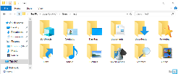
Places entire user profile in network-based container.
Extremely fast logon times.
Virtually eliminates profile corruption.
Works alongside existing User Environment Management platforms.
Benefits
Container
Profile Container
Profile Container
Office 365 Container
SMB Storage
App Masking
Java Redirection

Slide 18
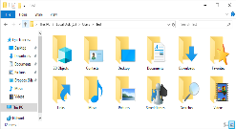


Places Office 365 cache data in network-based container.
Enables roaming of Outlook OST, OneDrive cache, Windows Search, and more…
Office apps have native performance and behavior.
Works alongside other profile management platforms.
Benefits
Container
Profile Container
Office 365 Container
Office 365 Container
SMB Storage
App Masking
Java Redirection

Slide 19












Application Management without sequencing, snapshotting, packaging, or virtualization.
All apps installed in base image.
Only apps a user is entitled to are revealed.
App entitlements can be changed in real time.
Works with fonts, plugins, and more…
Excellent app compatibility
Massively reduce the number of gold images that must be maintained
Benefits
Container
Profile Container
Office 365 Container
App Masking
App Masking
Java Redirection

Slide 20
Securely collocate multiple version of Java on same base image
Run each app or website with specific version of Java required for full functionality
Uses FSLogix App Masking to hide unused versions of Java when not needed
Benefits
Container
Profile Container
Office 365 Container
App Masking
Java Redirection
Java Redirection

Slide 21
Most customers are already eligible for WVD
Client
Customers are eligible to access Windows 10 single and multi session and Windows 7 with Windows Virtual Desktop (WVD) if they have one of the following licenses*:
Microsoft 365 E3/E5
Microsoft 365 A3/A5/Student Use Benefits
Microsoft 365 F1
Microsoft 365 Business
Windows 10 Enterprise E3/E5
Windows 10 Education A3/A5
Windows 10 VDA per user
Server
Customers are eligible to access Server workloads with Windows Virtual Desktop (WVD) if they have one of the following licenses:
RDS CAL license with active Software Assurance (SA)
.
*Customers can access Windows Virtual Desktop from their non-Windows Pro endpoints if they have a Microsoft 365 E3/E5/F1, Microsoft 365 A3/A5 or Windows 10 VDA per user license.
Pay only for the virtual machines (VMs), storage, and networking consumed when the users are using the service
Take advantage of options such as one-year or three-year Azure Reserved Virtual Machine Instances, which can save up to 72 percent versus pay-as-you-go pricing. Now with monthly payment options!

Slide 22
See if Windows Virtual Desktop is right for your customers
Take the self-assessment:
You need the ability to add users quickly and easily
You need to scale efficiently on demand
Your end-users need a seamless rich client experience with Outlook, Search, Cortana, OneDrive, and Skype
You need to manage different deployment types across different deployment planes
You need to bring Remote Desktop Services (RDS) to your users
You need to support both persistent and non-persistent environments
You need integrated security and management e.g. Microsoft 365, AAD
You need to run Windows 7 legacy applications post upcoming Win 7 EOL
You are in a regulated industry and need to meet strict compliance requirements
Your virtual desktop journey requires reuse of existing investments (e.g. Citrix)
You want to reduce management and deployment costs for Windows Server

Slide 23
Thank you

